Slide 1
File transfer protocol
By: Dipesh Tha Shrestha

Slide 2
Introduction
File Transfer Protocol (FTP)
Used to transfer data between computers via internet
Develop in 1971
Last updated in 1974 JULY
Server/Client model
Allow to transfer large files

Slide 3
WHY FTP?
Independency
Allow between client and server machine system files
Efficiency
Enable efficient data transfer
Security
It provide the a environment to transfer files indirectly and implicitly between users
Accessing by user name and password makes it reliable and safe to use FTP anywhere
Some FTP server allows people to use anonymous as a default user name

Slide 4
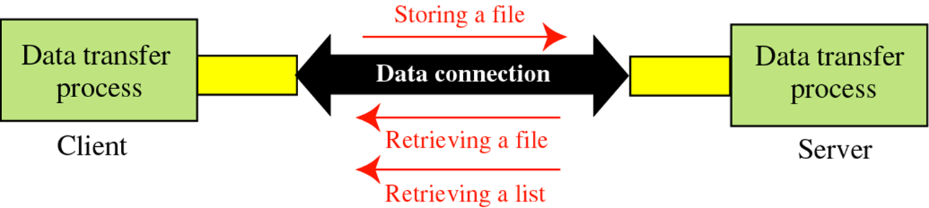
Transfer Ability
FTP allows file sharing between remote machines
Allow file transferring between computers that have different operating System
Availability
Available for almost all operating systems
Can be used in command prompt by using FTP commands
Can be used in the web browser
FTP applications

Slide 5
How does FTP work?
FTP has to be on both server and client computers to work
Connection
Control connection (port 21)
Used to send and receive FTP commands
Data connection (port 20)
Used to upload and download files
Processes
Data Transfer Process
Establishing the connection and managing the data channel
Protocol Interpreter
Interprets the protocol
let DTP be controlled using commands received over the control channel

Slide 6
Transferring mode between server and client
Active mode
Control connection port: Client: Large port (N>1023); Server: 21
Data connection port: Client: N+1; Server: 20
Passive mode
Control connection port: Client: Large port (N>1023); Server: 21
Data connection port: Client: N+1; Server: large port (P>1023)
File Transferring mode
ASCII mode
.txt, .html, .asp, .vbs,.js
Binary
.doc, .pdf, .mp3/mp4

Slide 7
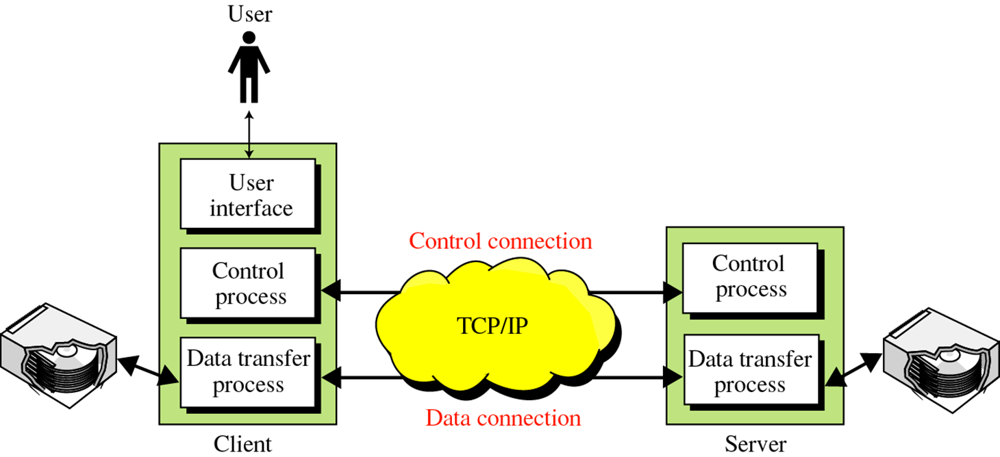

Slide 8
OBJECTIVES
It provides the sharing of files.
It is used to encourage the use of remote computers.
It transfers the data more reliably and efficiently.

Slide 9
Advantage
Speed: One of the biggest advantages of FTP is speed. The FTP is one of the fastest way to transfer the files from one computer to another computer.
Efficient: It is more efficient as we do not need to complete all the operations to get the entire file.
Security: To access the FTP server, we need to login with the username and password. Therefore, we can say that FTP is more secure.
Back & forth movement: FTP allows us to transfer the files back and forth. Suppose you are a manager of the company, you send some information to all the employees, and they all send information back on the same server.

Slide 10
DISADVANTAGE
Not a secure data transfer due to lack of encryption; must use secure alternative such as SFTP.
Passwords and usernames are in plain text making it simpler for an authorized user to gain access.
Difficulty scaling users or storage.
It requires more memory and programming effort.
It is hard to filter active mode FTP traffic on client side when firewall is in place.
It is not compatible with every system.

Slide 11
Where is FTP?
Desktop Environment
Use “ftp” command to implement FTP
FTP server
Used to keep files that are available users
Websites
Easy to update
Internet
Very efficient to get a specific file through the internet
Everywhere

Slide 12
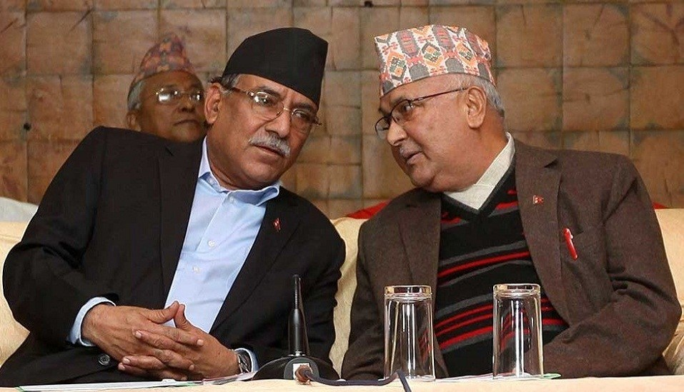
ANY QUESTION???

